Slide 1


Mubeen Arshad
mubeen.arshad441@gmail.com
https://github.com/Mubeen-Arshad

Slide 2
WISABI bank Analysis

Slide 3
KEY COMPONENTS OF THE DATASET
Customer Information
ATM location details
Transactional data

Slide 4
Data Analysis process
1
Understanding transaction patterns and trends, and define objectives
2
Data gathering and Data Preparation
3
Data Processing and Analysis
4
Visualization, generating insights and Recommendations

Slide 5
objective
Analyze ATM transactions and customer behavior to identify patterns, trends, and insights for optimizing banking services and customer experience.

Slide 6
Problem Statements
What are the most common transaction types, and how do they contribute to overall transaction volume?
What is the relationship between transaction types and transaction amounts, and how can we use this information to improve our service offerings?
What is the average transaction amount for "withdrawal" transactions, categorized by account type, and how does this amount vary across different ATM locations?
Is there a correlation between transaction volume and ATM availability in different cities, and how can we optimize ATM deployment for improved service?
Are there seasonal trends in transaction amounts, and how can we use this information to optimize cash reserves and marketing strategies?
Monitor transaction volume trends to identify peak months for service optimization.
What is the transaction behavior, in terms of transaction counts, across different occupations for both Wisabi Bank and non-Wisabi Bank customers, and how does it vary among these occupational groups?
What are the most common types of transactions conducted by students, and how do they differ from transactions made by customers in other occupations?

Slide 7
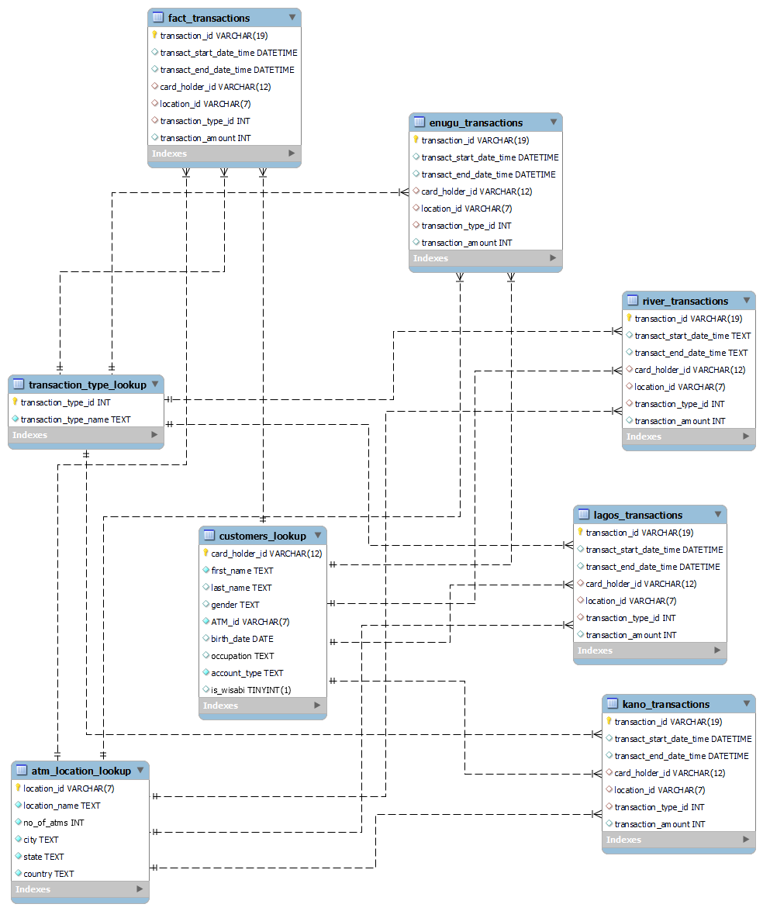
ER DIAGRAM

Slide 8
DATA ANALYSIS AND VISUALIZATION

Slide 9
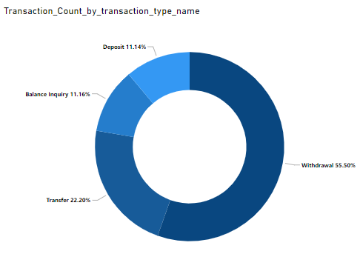
Understand transaction type
10.61%
The analysis of transaction types has revealed that the most common transaction type is "withdrawal,“. These findings indicate that customers primarily use ATMs for accessing cash.
4.69%

Slide 10
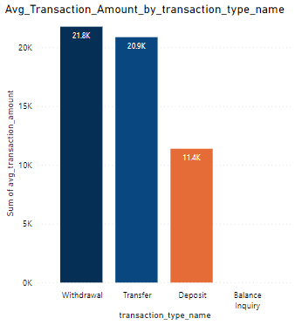
Transaction amount insights
There is variation in the average transaction amounts for different transaction types, with withdrawals involving larger amounts with a slight difference of transfers, and deposits having fewer amounts.

Slide 11
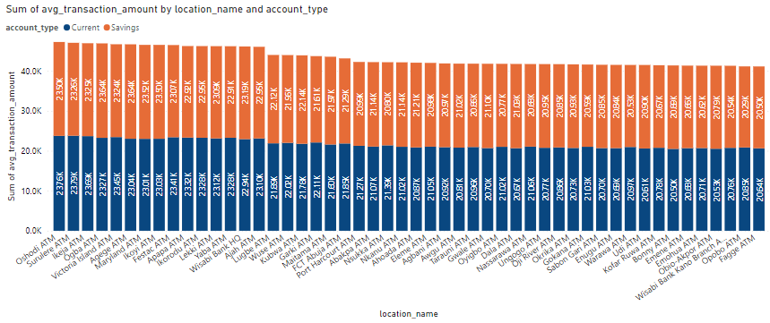
Analyze transaction volume
ATM withdrawal analysis reveals that average transaction amounts vary by location and are influenced by customer account types. Current account holders generally withdraw more money than those with saving accounts

Slide 12
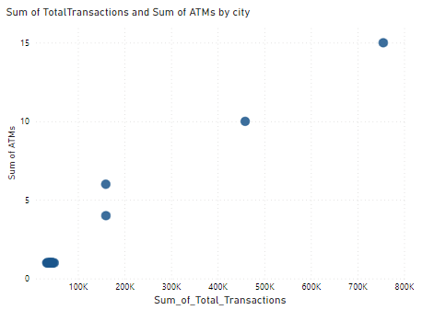
Optimizing atm deployment
Our analysis has revealed significant differences in the number of ATMs across cities. This variation suggests a mismatch between ATM availability and transaction demand.

Slide 13
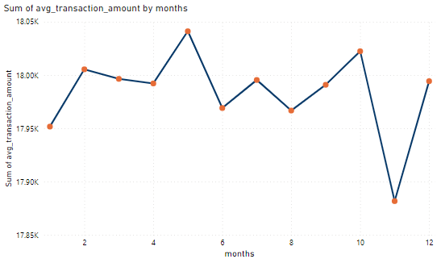
Seasonal insights
Our analysis has revealed distinct seasonal patterns in transaction amounts throughout the year. Specifically, some months have notably higher transaction averages.

Slide 14
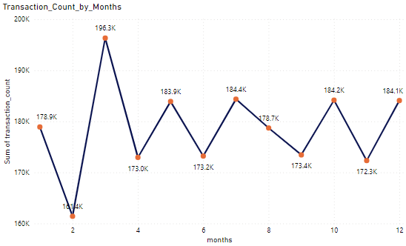
Transaction count by month
10%
4%
Variations in transaction volume across months may indicate seasonal trends, economic factors, or changes in customer behavior.

Slide 15
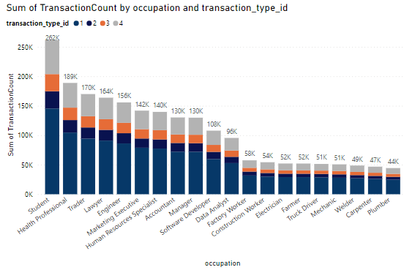
Transaction count by occupation
10%
4%
Withdrawal" transactions are notably more common among customers specifically among students compared to other transaction types, suggesting a greater reliance on cash for daily expenses.

Slide 16
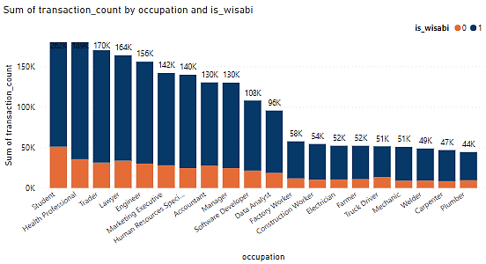
Occupation services
202K 189K
This query shows that “students ” have a higher transaction count than others. It also indicates that customer behavior varies based on their professions and financial needs.

Slide 17
RECOMMENDATIONS
Some of the recommendations based on the generated insights are:
Consider increasing ATM availability
Optimize maintenance schedules to minimize downtime
Add more ATMs in cities with fewer machines but high transaction volumes
Do cash reserve planning this approach can minimize the cash shortage risk during peak transaction months
Develop and promote seasonal financial products
Develop and offer financial products and services for the specific needs of the students
Highlight specific services that align with the transaction behaviors of each occupation
Actively seek feedback from customers of different occupations

Slide 18
Thankyou

